Slide 1
INTRODUCTION TO Immersion Ultrasonics
Basic Principles and Practices
ANDY WARD MinstNDT
Group Level 3

Slide 2
Subjects
01
What is “immersion”
02
Who Uses Immersion
03
General Principles
04
Application
05
Project Examples

Slide 3
WHAT IS Immersion?
01

Slide 4
A Brief Description!
Using the principles of ultrasonic inspection, immersion is just another way to couple the sound leaving the probe and entering the component.
There are several ways to do this, but the more common practices are:
Complete immersion of the component and the probe in liquid (usually water).
Or a column of water is sent from the probe to the component surface, usually referred to as squirter systems.
Due to the nature of the type of defect that is being sought, immersion systems will always have some element of mechanical control from simple 3 axis X, Y, Z systems to more complicated 12 axis robotic systems.

Slide 5
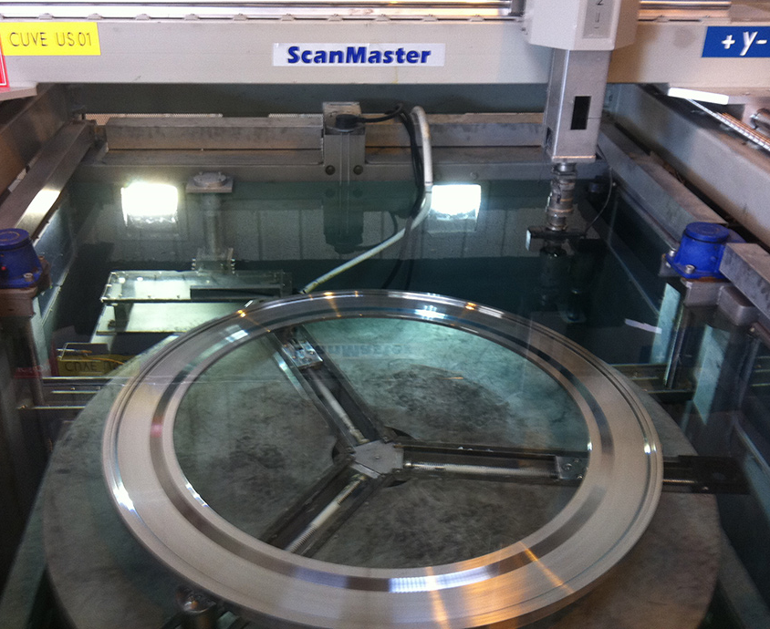
Typical Samples of Immersion Systems

Slide 6
Why Do Immersion?
Immersion is used to find defects/or features in a more controlled environment.
To find defects and features that could not be detected using the more conventional Contact methods.
Collect and analyse data using software.
To allow others to see results.
Store results for reference.
Repeatability.

Slide 7
Who Uses Immersion?
02

Slide 8
Who Uses Immersion?
The biggest users of immersion tend to be the forging and wrought material industry.
However the Composite industry is utilising the inspection more frequently.
This is generally to inspect product destined for the Aero Space industry. It is usually the Primes like Rolls Royce, GE Engines, Snecma, Pratt and Whitney, Honeywell, MTU etc. that set the criteria for such inspections.

Slide 9
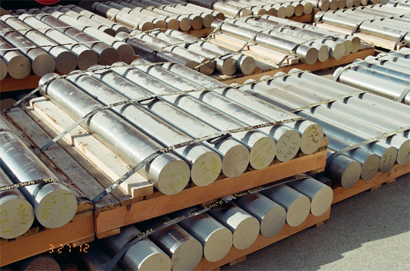
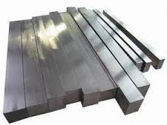
Who Uses Immersion?
The Raw material suppliers also use the Immersion method in some form to inspect their product, to ensure it meets the requirements of industry standards such as AMS-2154, 2630, 2631, RRP58002.
This is most likely to be in the form of Round Billet/Bar or Flat/Square Bar or Plate.

Slide 10
General Principles
03

Slide 11
The Big Difference!
If we compare Contact with immersion one of the big differences is the ‘Water Gap’.
The ‘Water Gap’ (WG) is the distance from the probe to the surface of the component under inspection. For most applications this is critical and needs to be controlled in such away that this distance remains constant throughout the inspection.
Why so critical?
The water gap in most cases has been optimise to allow the probe to perform at its best at a given distance, it could have been adjusted to:
Optimise the NSR (Near Surface Resolution)
Focus the inspection at a given depth.
Give a wide inspection envelope to allow a good NSR and Working Range.

Slide 12
The Big Difference!
A
B
C
Velocity of Water 1500m/s
Velocity of Steel 6000m/s
For the majority of inspections carried out we do not need to see the initial bang ‘A’ and the water Gap!! So we adjust the delay and range to only see the area of interest.
100mm
100mm
A
100mm
B
100mm
Probe
FWE
BWE
C

Slide 13
The Big Difference!

Slide 14
The Big Difference!
P1
P2
P3
P4
P5
P1 to P5
Multi Zone
Z1
Z2
Z3
Z4
Z5

Slide 15
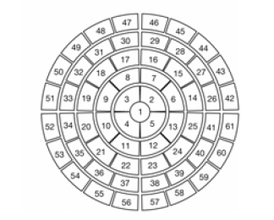
The Big Difference!
Multi Zone
Using Phased Array
1D Linear Array
2D Matrix
1D Annular Array
2D Sectorial annular

Slide 16
The Big Difference!
Single Probe Inspection With DAC Correction (TCG)
Distance Amplitude Correction
dB
Distance Amplitude Curve
100mm
Distance

Slide 17
The Big Difference!
Through Transmission
P1 Send
P2 Receive
Composite

Slide 18
The Big Difference!
Double Through Transmission
a
P1
c
b
Composite
a
b
c
Reflector (Glass)

Slide 19
Application
04

Slide 20
Application.
Ultrasonic Immersion testing as mentioned before is more commonly used for forged components either as raw material or further forged components, like aerospace discs.
However we can take the advantages immersion gives, to look at other components and fabrications.
Such as Composites, welds, brazing, electronics’, castings, complex alloy’s, microstructures etc…
We have the ability to collect data from these types of inspections that can be stored for further analysis and greater scrutiny. There are now systems that allow inspections to be performed remotely by an operator and analysed/sentenced by a inspector (level 2/3) in another country, after inspection or in real time!

Slide 21
Application.
Advantages:
Repeatability.
Stable.
Automation.
Control.
The ability to detect very small flaws/defects (0.001mm).
Locate flaws/defects more accurately.
Speed!
Data collection.
Save the data,
Annalise it after inspection.
Report and show findings.

Slide 22
Application.
Dis-advantages:
Setup times can be longer.
Not very portable.
May require Higher level of understanding and skill.
Can have limited scope.
Cost
Calibration
Skill
May require more than one piece of equipment.
Probes.

Slide 23
Project Examples
05

Slide 24
Project Examples.
The following examples are just some of the ways I have used the advantages immersion inspection to inspect components that could not be inspected with other methods.

Slide 25
Project Examples.
Depth of an EB Weld:
Customer needed to know the depth of penetration that the EB weld was reaching. This had to be between a set acceptance of 2.0mm to 3.5mm. The weld was not fully penetrating and posed several problems in detectability.
There were also misalignment issues where the weld could miss the joint.
1mm

Slide 26
Project Examples.
Component
Fig 1, No Weld
Fig 2, Welded
Probe
a
b
c
a
b
a
b
c
a
b
c
Sound Travel
Sound Travel
Gate
EB Weld
A scan
A scan
Jig

Slide 27
Project Examples .

Slide 28
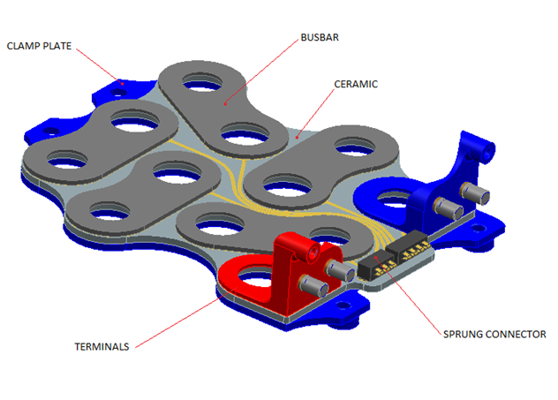
Project Examples.
Quality of Solder Joints on circuit board:
Customer had issues with the quality of solder joints of busbars to the ceramic plate of the component.
X-ray reviled that there was solder but not how well it is adhered.
1mm
Fig 1

Slide 29
Project Examples.
Quality of Solder Joints on circuit board:
Again we used the monitor of the back wall principle.
This would show that the better the bond the more transfer of sound through to the next medium and as such would be detectable in the amplitude of the back wall echo.
Busbar
Ceramic

Slide 30
Project Examples.
Quality of Solder Joints on circuit board:

Slide 31
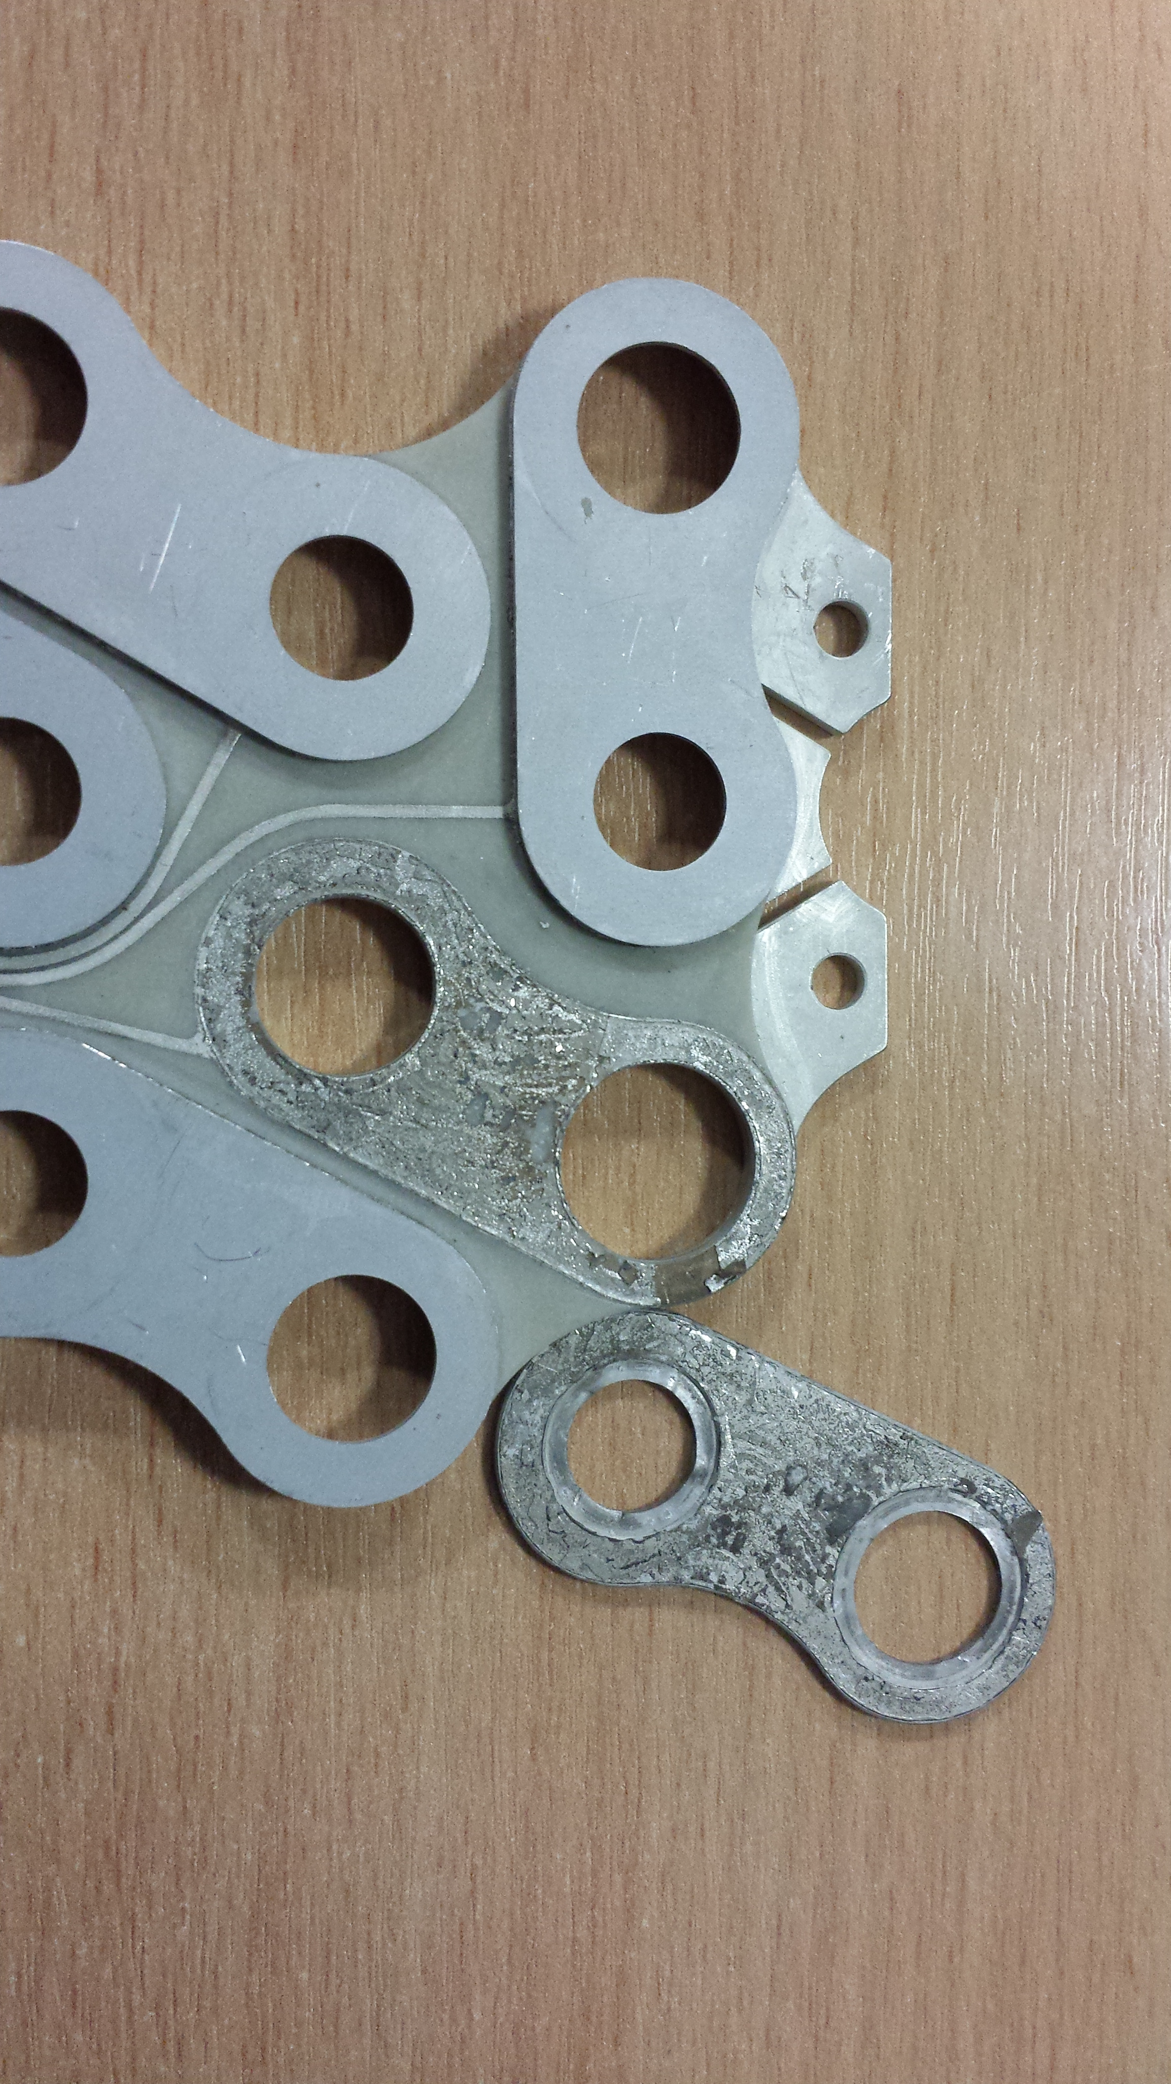
Project Examples.
Quality of Solder Joints on circuit board:
Busbar
Solder
Ceramic

Slide 32
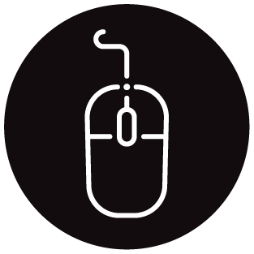
Andy Ward
+44 (0) 1332 257 700
andy.ward@intertek.com
intertek.com

